Slide 1
Application of Bi-LSTM for Protein-Protein Interaction
Presented By:
Sandeep Reddy Yaram (AP21110011538),
Chandra Sekhar Naidu Vattem (AP21110011576),
Sai Kumar Mundru (AP21110011624)
Guide: Dr. Anirban Bhar

Slide 2
Problem Statement
Background
Protein – Protein Interactions (PPIs) are key to biological functions like immune response, signalling and pathogen invasion.
Viruses like Dengue manipulate host proteins to aid replication and evade immune defense.
The Challenge
Experimental Methods (E.g., yeast two-hybrid, co-immunoprecipitation):
Time – consuming
Costly
Limited scalability for new viruses

Slide 3
Traditional Computational Methods:
Depend on curated databases or structural alignments.
Struggle with novel protein sequences or emerging viral strains.
Our Objective
Build a deep learning model using only amino acid sequences.
Predict PPIs without relying on structure or alignment data.

Slide 4
Dataset Construction
The PPIs datasets were downloaded from the Host-Pathogen Interaction Database 3.0 (HPIDB 3.0)
Redundant PPIs were excluded by using CD-HIT with an identity threshold of 0.90.
There is no golden standard for negative sample generation

Slide 5
To prepare the negative samples we collected information about sub cellular localization of both human and dengue
The proteins which are located at different sub cellular localization are less likely to interact with each other such pairs or proteins
The number of such pair of proteins are determined in accordance of number of positive sample to make sure there is no class imbalance
Goal: Create high-confidence negative examples (unlikely to interact).

Slide 6
CD-HIT Tool
CD-HIT stands for Cluster Database at High Identity with Tolerance.
It is a fast-clustering tool for biological sequences
It is used to remove redundant sequences.
How it works:
It compares sequences.
Groups sequences that are ≥ 90% identical (if threshold is 90%).
Keeps only one representative sequence from each group.
Here it is used to make the dataset diverse and non redundant

Slide 7
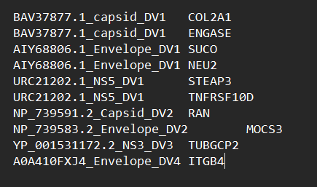
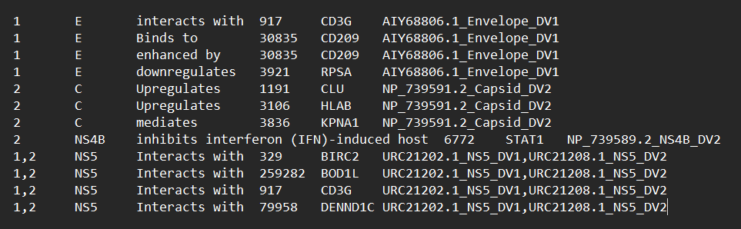
Dataset Preparation
Negative Samples
Positive Samples

Slide 8
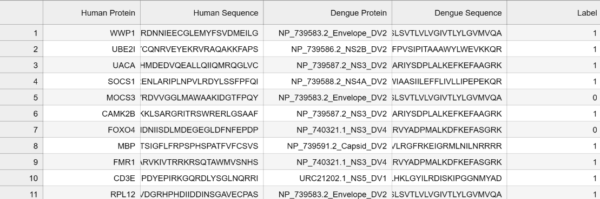
In the Negative Samples we will have Human and Dengue Sequences where we will map the Sequences names to the actual sequences and add label called interaction with value as 0.
In the Positive Samples we will give interaction label as 1.
The final Interactions we get is random merging of Negative Samples and Positive Samples and the below figure represents the interactions file.

Slide 9
Dataset Details
In the resultant file we have 1303 rows
Total Positive Samples are 612
Total Negative Samples are 691
Total Unique Human Sequences are 935
Total Unique Dengue Sequences are 22

Slide 10
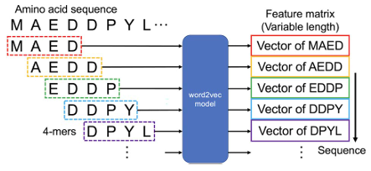
Preprocessing
Here we will take a sequence and then 4-mers extracted from protein sequences.
Then we will take those 4-mers and generate the embeddings
Which results for every 4-mer we get a 128 dimensional vector

Slide 11
Word2Vec
Word2Vec is a technique to convert words into numbers (vectors).
We have used a pretrained for embedding generation
Details
CBOW: It tries to predict the current word using its nearby words
Number of iterations is 100
Output: 128 dimensional vector
Here the generation of vectors is done with the help of GPU.

Slide 12
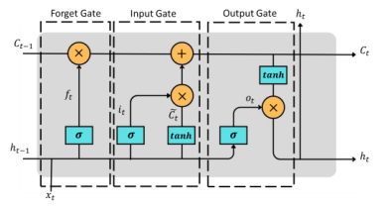
LSTM
Forget Gate: The forget gate's primary function is to determine which bits of the cell state are helpful.
Input Gate: The input gate has two primary goals. The first step is to determine what part of the new data should be used for the cell/memory update. Second, it tries to find out whether the new input data is worth remembering at all.
Output Gate: Determining the new hidden state is the output gate's primary function.
Advantage of LSTM networks is their ability to capture long-term dependencies in sequential data.

Slide 13
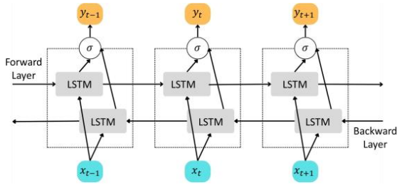
Bi-LSTM
An LSTM layer is made up of a sequence of LSTM cells, and the input data is processed only in a forward direction. On the other hand, Bi-LSTM includes an additional LSTM layer that processes the data in a backward direction, as shown in Figure. Training a Bi-LSTM network is equivalent to training two separate unidirectional LSTM networks. One of these networks is trained on the original input sequence, while the other is trained on a reversed copy of the input sequence.
This approach provides the network with more contextual information, leading to faster and more comprehensive learning of the problem.
An unfolded view of Bi-LSTM

Slide 14
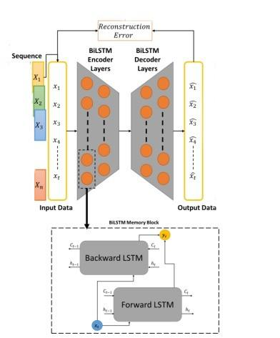
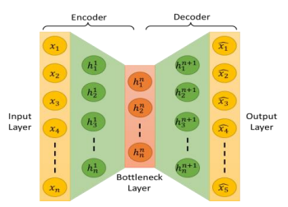
Goal of Bi-LSTM
The goal is to learn a compressed representation of the input data in the encoding phase and then reconstruct the original timeseries data in the decoding phase. The model consists of two main components: the encoder and the decoder. The encoder takes the input timeseries data and maps it to a lower-dimensional representation using Bi-LSTM layers. The decoder then takes the encoded representation and reconstructs the original timeseries data using another set of Bi-LSTM layers
A reconstruction error ( ) is calculated in a typical Autoencoder model to minimize the difference between the output and the input.
The above images are inspired from the : https://arxiv.org/pdf/2303.09703

Slide 15
Model Architecture
BiLSTM Autoencoder (Human/DENV):
Encoder: BiLSTM(64) → BiLSTM(32) + Dropout.
Decoder: BiLSTM(32) → BiLSTM(64) → TimeDistributed(Dense(128)).
Output: 128D embedding (average over sequence).
Fully Connected Neural Network (FCNN) Classifier:
Input: 256D (Human + DENV embeddings).
Layers: Dense(512 → 256 → 128) + BatchNormalization/Dropout.
Output: Sigmoid (0–1 interaction probability).

Slide 16
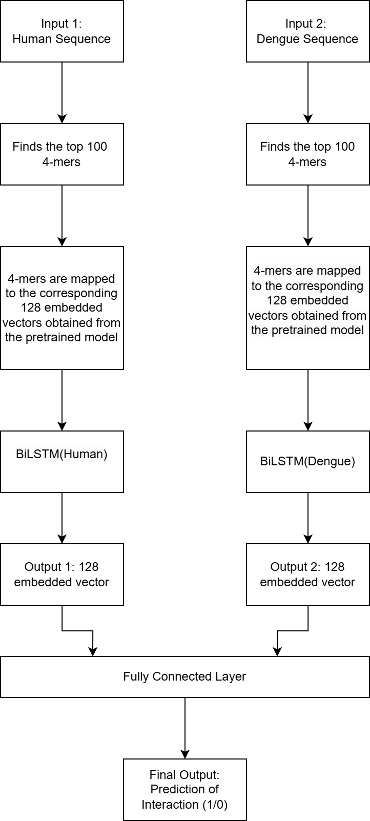
Flowchart

Slide 17
Hyper Parameters / Tuning
Input Sequence Length:
Human: {100, 200, 300} | Dengue: {100, 150, 200}
LSTM Units:
Layer 1: 32–128 (BiLSTM) | Layer 2: 16–64 (BiLSTM)
Dropout Rate: 0.0–0.5 (Interlayer regularization)
Learning Rate: 1e-4 – 1e-2 (Log scale)

Slide 18
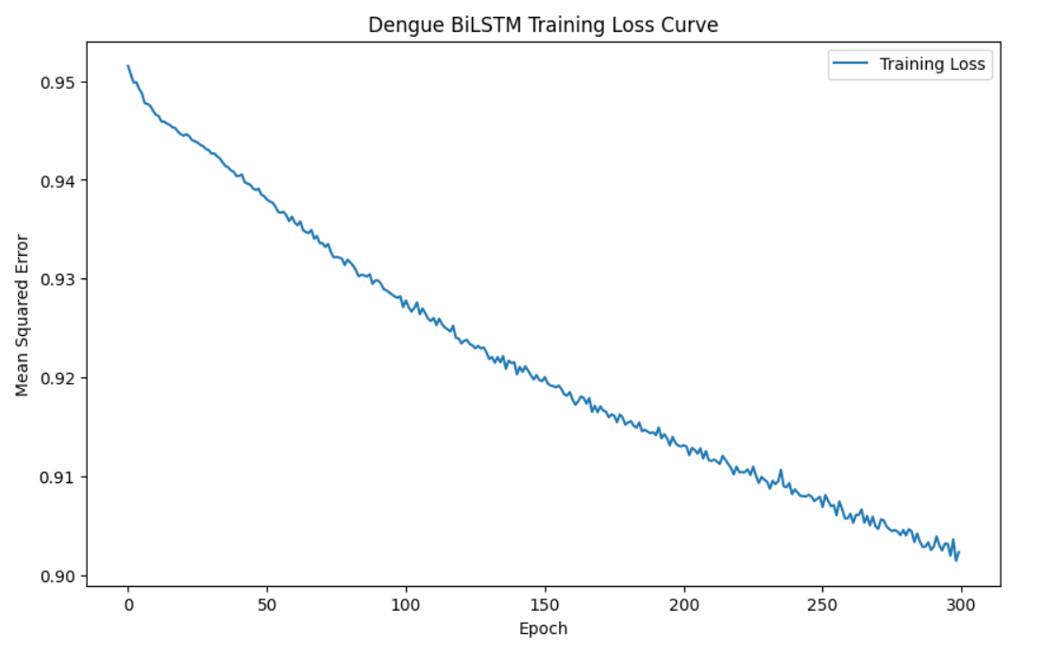
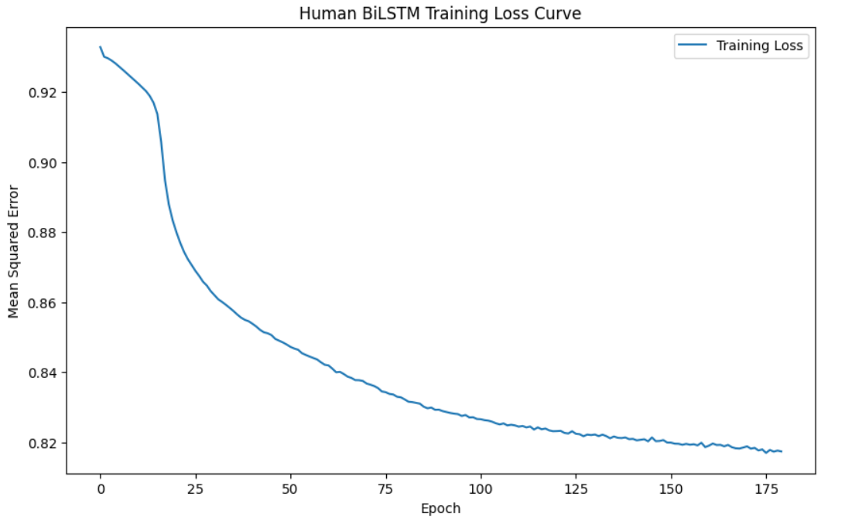
Results

Slide 19
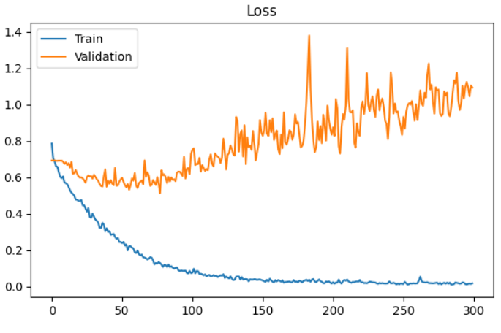
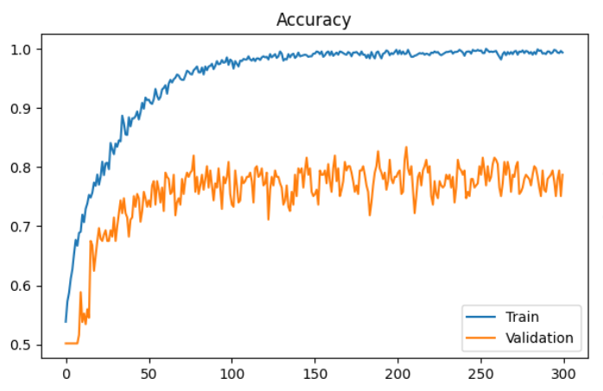

Slide 20
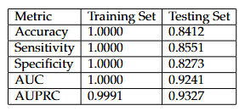
The Proposed deep learning model, using Bi-LSTM autoencoders and a FCNN classifier, successfully predicted human-dengue protein interaction based on amino acid sequences
The Key outcomes are:

Slide 21
Conclusion
Developed a deep learning framework using Bi-LSTM and FCNN to predict Human-Dengue PPIs from amino acid sequences.
Model offers a fast, scalable and sequence-based method for discovering potential viral interactions.
Provides a useful computational tool to guide experimental validation and antiviral research.
The model can also be adapted to study other viral diseases, expanding its applicability to broader host-pathogen interaction research.

Slide 22
Limitations
Simplified Sequence Representation / Embeddings: The use of averaged Bi-LSTM embeddings on 4-mers may overlook complex, long-range relationships and structural features critical for some protein-protein interactions.
High Data Dependency: Model performance strongly depends on the quality and diversity of the training data. Imperfect labelling of negative samples (base on subcellular localization) could introduce bias.

Slide 23
Black-Box Nature of Deep Learning: The Bi-LSTM and FCNN models provide limited interpretability, making it challenging to extract biologically meaningful insights form the interaction predictions.
Potential Overfitting Risk:
Despite strong validation metrics, perfect training scores hint at potential overfitting, emphasizing the need for careful testing on completely unseen or new datasets.
Scalability to New Viruses:
While the model works for Dengue, adaptation to different viruses may require retraining or further tuning, depending on sequence variability and available data.

Slide 24
Future Scope
Multi-modal Learning
Combine sequence data with 3D Structural predictions (e.g., AlphaFold2).
Goal: Improve biological realism and prediction accuracy.
Dynamic Interaction Modeling
Integrate time-series data (transcriptomics/ proteomics) during different infection stages.
Goal: Predict stage-specific human-virus protein interactions.

Slide 25
Experimental Validation
Select top high-confidence predictions.
Validate using wet-lab methods:
Yeast two-hybrid screens
Co-immunoprecipitation
Surface plasmon resonance
Goal: Turn computational predictions into confirmed biological insights.
Alternative Model Architectures
Investigate Graph Neural Networks (GNNs).
Model proteins as nodes, interactions as edges.
Goal: Better representation of biological networks and predict new interactions.

Slide 26
Publication
Abstract is Prepared to submit in
The 24th international conference on bioinformatics (InCoB 2025)

Slide 27
Thank You

